Slide 1
Introduction to Virtual Machines
Carl Waldspurger (SB SM ’89, PhD ’95), VMware R&D

Slide 2
Overview
Virtualization and VMs
Processor Virtualization
Memory Virtualization
I/O Virtualization
Resource Management

Slide 3
Types of Virtualization
Process Virtualization
Language-level Java, .NET, Smalltalk
OS-level processes, Solaris Zones, BSD Jails, Virtuozzo
Cross-ISA emulation Apple 68K-PPC-x86, Digital FX!32
Device Virtualization
Logical vs. physical VLAN, VPN, NPIV, LUN, RAID
System Virtualization
“Hosted” VMware Workstation, Microsoft VPC, Parallels
“Bare metal” VMware ESX, Xen, Microsoft Hyper-V
Notes:
Virtual systems
Abstract physical components/details using logical objects
Dynamically bind logical objects to physical configurations
This talk will be concentrating system virtualization.

Slide 4
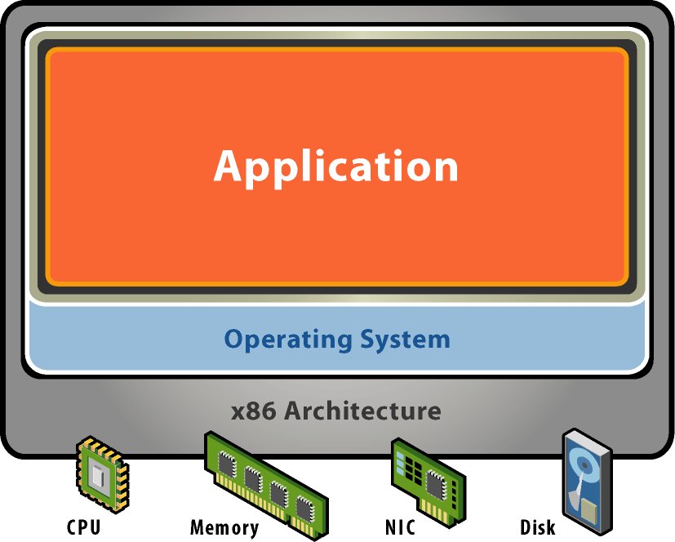
Starting Point: A Physical Machine
Physical Hardware
Processors, memory, chipset, I/O devices, etc.
Resources often grossly underutilized
Software
Tightly coupled to physical hardware
Single active OS instance
OS controls hardware

Slide 5
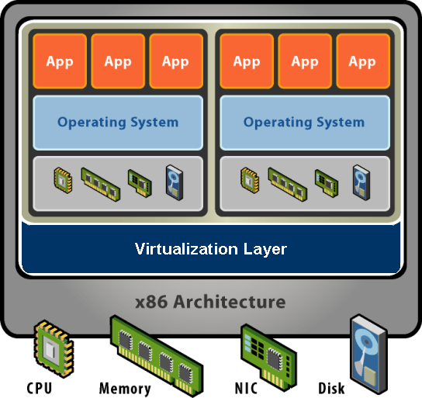
What is a Virtual Machine?
Software Abstraction
Behaves like hardware
Encapsulates all OS and application state
Virtualization Layer
Extra level of indirection
Decouples hardware, OS
Enforces isolation
Multiplexes physical hardware across VMs
Notes:
Virtualization can be defined many ways. I will try to define it formally and also define it by giving a few examples. However loosely, virtualization is the addition of a software layer (the virtual machine monitor) between the hardware and the existing software that exports an interface at the same level as the underlying hardware.
In the strictest case the exported interface is the exact same as the underlying hardware and the virtual machine monitor provides no functionality except multiplexing the hardware among multiple VMs. This was largely the case in the old IBM VM/360 systems.
However the layer really can export a different hardware interface as the case in cross-ISA emulators. Also the layer can provide additional functionality not present in the operating system.
I think of virtualization as the addition of a layer of software that can run the original software with little or no changes.

Slide 6
Virtualization Properties
Isolation
Fault isolation
Performance isolation
Encapsulation
Cleanly capture all VM state
Enables VM snapshots, clones
Portability
Independent of physical hardware
Enables migration of live, running VMs
Interposition
Transformations on instructions, memory, I/O
Enables transparent resource overcommitment, encryption, compression, replication …
Notes:
Virtualization has three main properties that give rise to all its applications.
Isolation
First, virtualization provides isolation. Isolation is key for many applications and comes in several flavors.
Fault Isolation. If one virtual machine contains a buggy operating system, that OS can start scribbling all over physical memory. These wild rights must be contained within the VM boundaries.
Performance Isolation. Ideally VMs performance would be independent of the activity going-on on the hardware. This must be accomplished by smart scheduling and resource allocation policies in the monitor.
Software Isolation. Most of the issues with computers today are complex software configurations. DLL hell on PCs, operating system and library versions, viruses, and other security threats. VMs are naturally isolated for each other by running in separate software environments.
Encapsulation
Encapsulation is the property that all VM state can be described and recorded simply. The VM state is basically the dynamic memory, static memory, and the register state of the CPU and devices. These items typically have a simple layout and are easy to describe. We can checkpoint a VM by writing out these items to a few files. The VM can be moved and copied by moving these files around. You can think about this as similar to doing a backup at the block level vs. doing a backup by recording all the packages, configuration and data files that encompass a file system.
Interposition
At some level all access to the hardware passes through the monitor first. This gives the monitor and chance to operate on these accesses. The best example of this is encrypting all data written to a disk. The advantage of this is that it does it without the knowledge of the OS.
Why not in the OS?
This brings up a good point. Why not do these things in the OS. By splitting up the system this way the OS functions more like a large application library. The VMM functions more like a smart set of device drivers. This is a nice split and can simplify overall system design. It also provides a natural administration boundary. However the monitor is often at a disadvantage because it does not have the same insight into what’s happening as the OS has. For example, the OS knows the distinction between data and metadata when implementing an encrypted file system. So there is a tradeoff there.

Slide 7
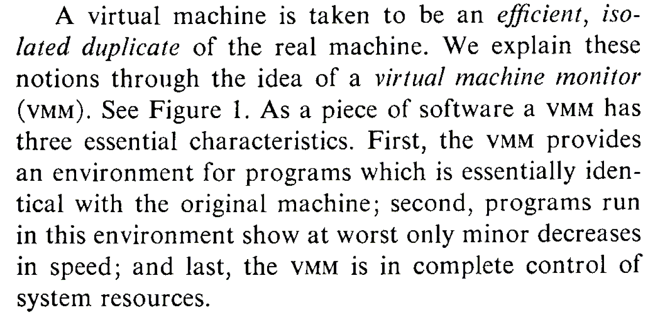
What is a Virtual Machine Monitor?
Classic Definition (Popek and Goldberg ’74)
VMM Properties
Fidelity
Performance
Safety and Isolation

Slide 8
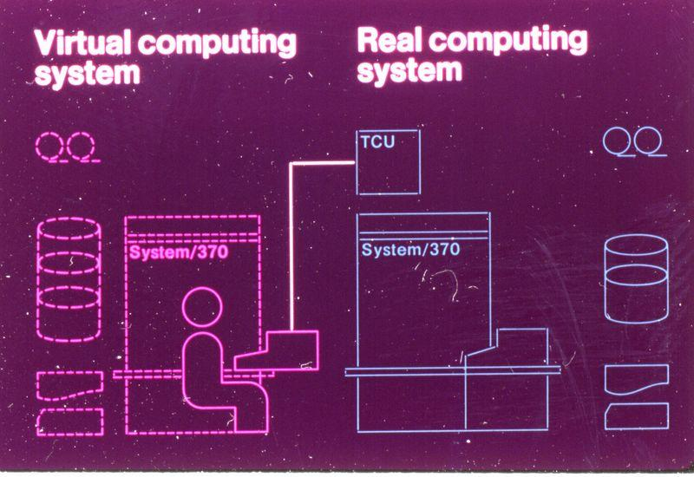
Classic Virtualization and Applications
Classical VMM
IBM mainframes: IBM S/360, IBM VM/370
Co-designed proprietary hardware, OS, VMM
“Trap and emulate” model
Applications
Timeshare several single-user OS instances on expensive hardware
Compatibility
From IBM VM/370 product announcement, ca. 1972

Slide 9
Modern Virtualization Renaissance
Recent Proliferation of VMs
Considered exotic mainframe technology in 90s
Now pervasive in datacenters and clouds
Huge commercial success
Why?
Introduction on commodity x86 hardware
Ability to “do more with less” saves $$$
Innovative new capabilities
Extremely versatile technology

Slide 10
Modern Virtualization Applications
Server Consolidation
Convert underutilized servers to VMs
Significant cost savings (equipment, space, power)
Increasingly used for virtual desktops
Simplified Management
Datacenter provisioning and monitoring
Dynamic load balancing
Improved Availability
Automatic restart
Fault tolerance
Disaster recovery
Test and Development

Slide 11
Representative Products
VM (IBM), very early, roots in System/360, ’64 –’65
Bochs, open source emulator.
Xen, open source VMM, requires changes to guest OS.
SIMICS, full system simulator
VirtualPC (Microsoft)

Slide 12
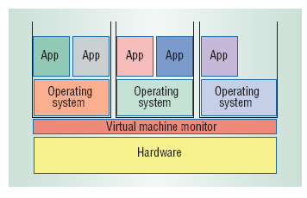
Virtual Machine Monitors (VMMs)
Virtual machine monitor (VMM) or hypervisor is software that supports VMs
VMM determines how to map virtual resources to physical resources
Physical resource may be time-shared, partitioned, or emulated in software
VMM is much smaller than a traditional OS;
isolation portion of a VMM is ≈ 10,000 lines of code

Slide 13
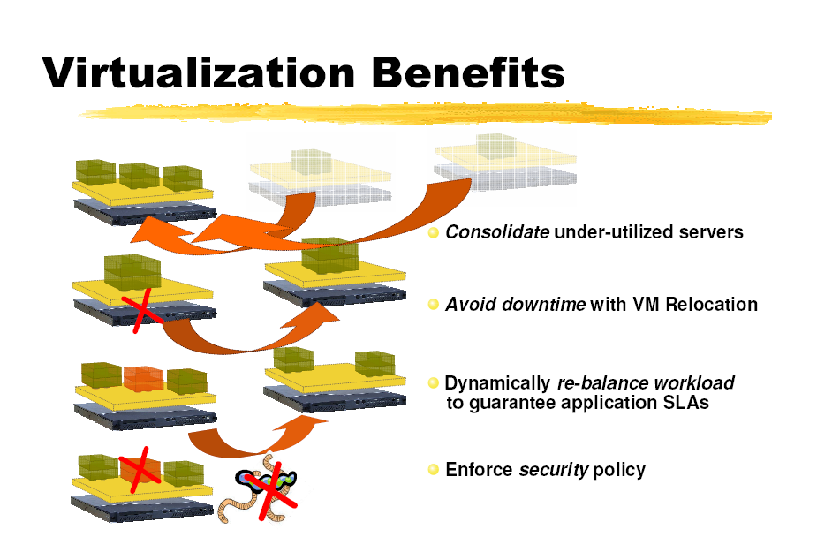
Virtual Machine Monitors (VMMs)

Slide 14
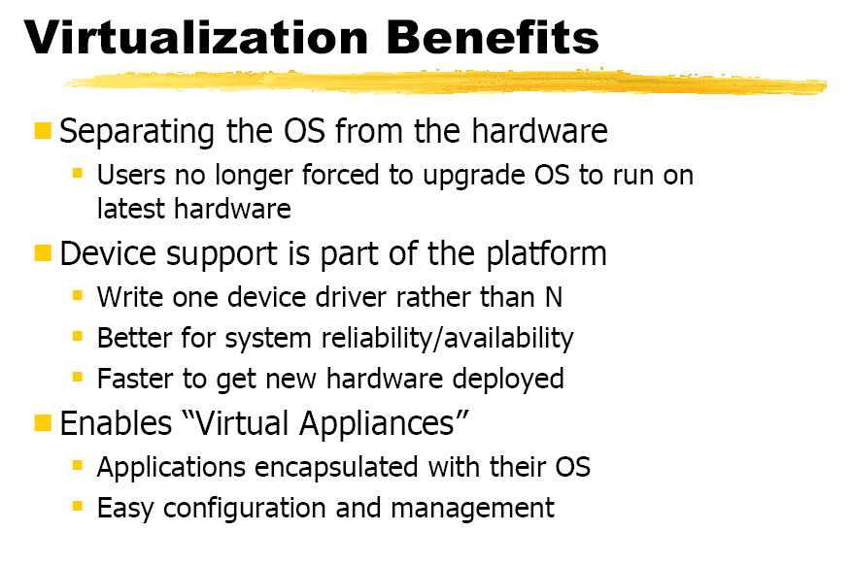
Virtual Machine Monitors (VMMs)

Slide 15
Abstraction, Virtualization of Computer System
Modern computer system is very complex
Hundreds of millions of transisters
Interconnected high-speed I/O devices
Networking infrastructures
Operating systems, libraries, applications
Graphics and networking softwares
To manage this complexity
Levels of Abstractions
seperated by well-defined interfaces
Virtualizations

Slide 16
Abstraction, Virtualization of Computer System
Levels of Abstraction
Allows implementation details at lower levels of design to be ignored or simplified
Each level is seperated by well-defined interfaces
Design of a higher level can be decoupled from the lower levels

Slide 17
Abstraction, Virtualization of Computer System
Disadvantage
Components designed to specification for one interface will not work with those designed for another.
Component A
Interface A
Component A
Interface A
Interface B
Component A
Interface B

Slide 18
Abstraction vs. Virtualization of Computer System
Virtualization
Similar to Abstraction but doesn’t always hide low layer’s details
Real system is transformed so that it appears to be different
Virtualization can be applied not only to subsystem, but to an Entire Machine → Virtual Machine
Resource AA
BB
BB’
isomorphism
Resource A
B
B’

Slide 19
Abstraction, Virtualization of Computer System
Virtualization
Applications or OS
Application uses virtual disk as Real disk
Virtualized
Disk
Virtualization
File
File
Abstraction
Real Disk

Slide 20
Architecture, Implementation Layers
Architecture
Functionality and Appearance of a computer system but not implementation details
Level of Abstraction = Implementation layer
ISA, ABI, API
Application
Programs
Libraries
ABI
Operating System
Drivers
Memory
Manager
Scheduler
API
ISA
Execution Hardware
Memory
Translation
System Interconnect (Bus)
Controllers
Controllers
IO Devices,
Networking
Main Memory

Slide 21
Architecture, Implementation Layers
Implementation Layer : ISA
Instruction Set Architecture
Divides hardware and software
Concept of ISA originates from IBM 360
IBM System/360 Model (20, 40, 30, 50, 60, 62, 70, 92, 44, 57, 65, 67, 75, 91, 25, 85, 95, 195, 22) : 1964~1971
Various prices, processing power, processing unit, devices
But guarantee a software compatibility
User ISA and System ISA

Slide 22
Architecture, Implementation Layers
Implementation Layer : ABI
Application Binary Interface
Provides a program with access to the hardware resource and services available in a system
Consists of User ISA and System Call Interfaces

Slide 23
Architecture, Implementation Layers
Implementation Layer : API
Application Programming Interface
Key element is Standard Library ( or Libraries )
Typically defined at the source code level of High Level Language
clib in Unix environment : supports the UNIX/C programming language

Slide 24
What is a VM and Where is the VM?
What is “Machine”?
2 perspectives
From the perspective of a process
ABI provides interface between process and machine
From the perspective of a system
Underlying hardware itself is a machine.
ISA provides interface between system and machine

Slide 25
What is a VM and Where is the VM?
Machine from the perspective of a process
ABI provides interface between process and machine
Application Software
Application
Programs
Libraries
System calls
Operating System
Drivers
Memory
Manager
Scheduler
User ISA
Execution Hardware
ABI
Memory
Translation
Machine
System Interconnect (Bus)
Controllers
Controllers
IO Devices,
Networking
Main Memory

Slide 26
What is a VM and Where is the VM?
Machine from the perspective of a system
ISA provides interface between system and machine
Application Software
Application
Programs
Libraries
Operating System
Operating System
Drivers
Memory
Manager
Scheduler
System ISA
User ISA
Execution Hardware
ISA
Memory
Translation
Machine
System Interconnect (Bus)
Controllers
Controllers
IO Devices,
Networking
Main Memory

Slide 27
What is a VM and Where is the VM?
Virtual Machine is a Machine.
VM virtualizes Machine Itself!
There are 2 types of VM
Process-level VM
System-level VM
VM is implemented as combination of
Real hardware
Virtualizing software

Slide 28
What is a VM and Where is the VM?
Process VM
VM is just a process from the view of host OS
Application on the VM cannot see the host OS
Application Process
Guest
Application Software
Virtualizing
Software
Virtual
Machine
System calls
System calls
Runtime
ABI
OS
User ISA
User ISA
ABI
Machine
Host
Hardware

Slide 29
What is a VM and Where is the VM?
System VM
Provides a system environment
Application Software
Applications
Guest
Operating System
OS
Virtualizing
Software
Virtual
Machine
Runtime
System ISA
User ISA
ISA
Machine
Host
Hardware

Slide 30
What is a VM and Where is the VM?
System VM
Example of a System VM as a process
VMWare
Applications
Other Host Applications
Guest OS
Virtualizing
Software (VMWare)
Host OS
Hardware

Slide 31
VMM Overhead?
Depends on the workload
User-level processor-bound programs (e.g., SPEC) have zero-virtualization overhead
Runs at native speeds since OS rarely invoked
I/O-intensive workloads ⇒ OS-intensive ⇒ execute many system calls and privileged instructions ⇒ can result in high virtualization overhead
For System VMs, goal of architecture and VMM is to run almost all instructions directly on native hardware
If I/O-intensive workload is also I/O-bound ⇒ low processor utilization since waiting for I/O ⇒ processor virtualization can be hidden ⇒ low virtualization overhead

Slide 32
Requirements of a Virtual Machine Monitor
A VM Monitor
Presents a SW interface to guest software,
Isolates state of guests from each other, and
Protects itself from guest software (including guest OSes)
Guest software should behave on a VM exactly as if running on the native HW
Except for performance-related behavior or limitations of fixed resources shared by multiple VMs
Guest software should not be able to change allocation of real system resources directly
Hence, VMM must control ≈ everything even though guest VM and OS currently running is temporarily using them
Access to privileged state, Address translation, I/O, Exceptions and Interrupts, …

Slide 33
Requirements of a Virtual Machine Monitor
VMM must be at higher privilege level than guest VM, which generally run in user mode
Execution of privileged instructions handled by VMM
E.g., Timer interrupt: VMM suspends currently running guest VM, saves its state, handles interrupt, determine which guest VM to run next, and then load its state
Guest VMs that rely on timer interrupt provided with virtual timer and an emulated timer interrupt by VMM
Requirements of system virtual machines are ≈ same as paged-virtual memory:
At least 2 processor modes, system and user
Privileged subset of instructions available only in system mode, trap if executed in user mode
All system resources controllable only via these instructions

Slide 34
Overview
Virtualization and VMs
Processor Virtualization
Memory Virtualization
I/O Virtualization
Resource Management

Slide 35
Processor Virtualization
Trap and Emulate
Binary Translation

Slide 36
Trap and Emulate
Guest OS + Applications
Unprivileged
Page
Fault
Undef
Instr
vIRQ
Virtual Machine Monitor
Privileged
MMU
Emulation
CPU
Emulation
I/O
Emulation
Notes:
Direct execution

Slide 37
“Strictly Virtualizable”
A processor or mode of a processor is strictly virtualizable if, when executed in a lesser privileged mode:
all instructions that access privileged state trap
all instructions either trap or execute identically
Notes:
Again another operational definition. This idea behind strictly virtualizable is the whether trap and emulate will work.
The x86 is not strictly virtualizable. One reason is the popf instruction. popf takes a word off the stack and puts in into the flags register. One flag in that register is the interrupt enable flag. At system level the flag is updated by popf. When the designers of the x86 introduced user mode they realized that modifications of this flag by the user would break the OS. So they solved this by silently dropping updates to the IF at user level. This works for OS’s put breaks VMMs. When a VMM runs the OS by boosting it into user level all modifications the OS make to the IF are silently dropped and the VMM looses track of whether the OS whats interrupts to be enabled or disabled. The way to do this would be to make popf trap, or better yet make popf’s that modify IF to trap.
Note that these conditions are necessary but not sufficient. For example on the x86 there are several other reasons why trap and emulate will not work.

Slide 38
Issues with Trap and Emulate
Not all architectures support it
Trap costs may be high
VMM consumes a privilege level
Need to virtualize the protection levels

Slide 39
Binary Translation
Guest Code
Translation Cache
vEPC
mov ebx, eax
mov ebx, eax
start
cli
mov [VIF], 0
and ebx, ~0xfff
and ebx, ~0xfff
mov ebx, cr3
mov [CO_ARG], ebx
sti
call HANDLE_CR3
ret
mov [VIF], 1
test [INT_PEND], 1
jne
call HANDLE_INTS
jmp HANDLE_RET
Notes:
Dynamic binary translation is used in virtualizing the CPU by translating potentially dangerous (or non-virtualizable) instruction sequences one-by-one into safe instruction sequences.
It works like this:
The monitor inspects the next sequence of instructions. An instruction sequence is typically defined as the next basic block, that is all instructions up to the next control transfer instruction such as a branch. There may be reasons to end a sequence earlier or go past a branch but for now lets assume we go to the next branch.
Each instruction is translated and the translation is copied into a translation cache.
Instructions are translated as follows:
Instructions which pose no problems can be copied into the translation cache with modification. We call these “ident” translations.
Some simple dangerous instructions can be translated into a short sequence emulation code. This code is placed directly into the translation cache. We call this “inline” translation. An example is the modification of the Interrupt Enable flag.
Other dangerous instructions need be performed by emulation code in the monitor. For these instructions calls to the monitor are made. These are called “Call-outs”. An example of these is a change to the page table base.
The branch ending the basic block needs a call out.
The monitor can now jump to the start of the translated basic block with the virtual registers in the hardware registers.
So dangerous instructions can be privileged instructions, non-virtualizable instructions, control flow, memory accesses.

Slide 40
Issues with Binary Translation
Translation cache management
PC synchronization on interrupts
Self-modifying code
Notified on writes to translated guest code
Protecting VMM from guest

Slide 41
Overview
Virtualization and VMs
Processor Virtualization
Memory Virtualization
I/O Virtualization
Resource Management

Slide 42
Memory Virtualization
Guest OS needs to see a zero-based memory space
Terms:
Machine address -> Host hardware memory space
“Physical” address -> Virtual machine memory space

Slide 43
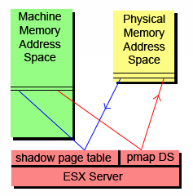
Memory Virtualization
Translation from MPN (machine page numbers) to PPN (physical page numbers) is done thru a pmap data structure for each VM
Shadow page tables are maintained for virtual-to-machine translations
Allows for fast direct VM to Host address translations
Easy remapping of PPN-to-MPN possible transparent to VM

Slide 44
Memory Virtualization
Shadow Page Tables
Nested Page Tables

Slide 45
Traditional Address Spaces
0
4GB
Virtual Address Space
0
4GB
Physical Address Space
Notes:
In a traditional system there are typically 2 address spaces – the virtual address space (VAS) and the physical address space (PAS). The OS and user processes run in the VAS. The OS manages the mapping from VAS to PAS through the use of the Memory Management Unit (MMU) provided in the processor. The OS maintains a page table that maps each page in the current VAS to a page in the PAS. Typically the OS will maintain one page table per user level process.

Slide 46
Traditional Address Translation
Virtual Address
TLB
Physical Address
₁
₄
₂
₅
₃
Operating System’s
Page Fault Handler
Process
Page Table
₂
Notes:
Lets follow the path when the required mapping is not in the TLB.
There is a miss in the TLB. The hardware will walk the current process’s page table to find the mapping. The page table structure will probably be more complicated than I’m showing here.
One of two things can happen:
The required mapping is found in the page table and placed in the TLB. The instruction is restarted and all proceeds normally. Note that in this case the hardware does all the work.
The required mapping is not present. An page fault exception is generated by the hardware and trapped into the operating system. The OS will do what it does to figure out the correct mapping.
The new translation is put into the current process’s page table.
The OS resume’s execution at the faulting nstruction. Now the hardware TLB refill mechanism will work.
The hardware put the new mapping in the TLB and life goes on.

Slide 47
Virtualized Address Spaces
0
4GB
Virtual Address Space
Guest Page Table
0
4GB
Physical Address Space
VMM PhysMap
0
4GB
Machine Address Space
Notes:
In a virtualized system the physical address layer becomes the virtual-physical address layer. We continue to call this the physical address layer to remain consistent with the guest’s view. However the real memory of the system is renamed to the machine address layer. The VMM is responsible for maintaining the current VM’s mapping from physical addresses to machine addresses. Most of the machine memory backing the physical address layer can be allocated on demand.

Slide 48
Virtualized Address Spaces w/ Shadow Page Tables
0
4GB
Virtual Address Space
Shadow
Page Table
Guest Page Table
0
4GB
Physical Address Space
VMM PhysMap
0
4GB
Machine Address Space
Notes:
Because of the vast number of instructions that access memory, including the instruction fetch itself, the hardware TLB must be used to translate virtual addresses to machine addresses. So the common case should be that the TLB holds the virtual to machine mapping. To do this we can use a shadow page table. The real hardware MMU points to the shadow page table. The shadow page table holds virtual to machine mappings. The VMM page fault handler is responsible for filling in the appropriate entries in the shadow page table based on the guest page table and PhysMap.

Slide 49
Virtualized Address Translation w/ Shadow Page Tables
Virtual Address
TLB
Machine Address
₄
₁
₅
₂
₆
₃
Shadow
Page Table
Guest
Page Table
₃
PMap
₂
_{A}
Notes:
Lets follow the path when the required mapping is not in the TLB.
There is a miss in the TLB. The hardware will walk the shadow page table to find the mapping. The page table structure will probably be more complicated than I’m showing here.
One of two things can happen:
The required mapping is found in the page table and placed in the TLB. The instruction is restarted and all proceeds normally. Note that in this case the hardware does all the work.
The required mapping is not present. An page fault exception is generated by the hardware and trapped into the VMM. The VMM needs to translate the virtual address to a machine address. It starts by walking the guest’s page table to determine the virtual to physical mapping. Note that the layout of the guest page table will be determined by the hardware being virtualized.
Once the VMM finds the guest mapping one of two things can happen:
The guest mapping is not present. In this case the guest expects a page fault exception. So the VMM must generate an exception on the virtual cpu state and resume executing on the first instruction of the guest exception handler. This is called a true page fault because the hardware page fault results in a guest visible page fault.
If the guest mapping is present then the VMM must translate the physical page to a machine page. This is called a hidden page fault because the hardware fault is a fault that would not have occurred in non-virtualized system. In order to translate the physical page to machine page the VMM must look in a data structure that maps physical pages to machine pages. This data structure is defined by the VMM, for example PMap. (A) The VMM might have perform further processing if there is no machine page backing the physical page or in other special circumstances. More on this later.
The virtual to machine translation is complete. The new translation is put into the shadow page table.
The VMM restarts the guest instruction that faulted. Now the hardware TLB refill mechanism will work.
The hardware put the new mapping in the TLB and life goes on.

Slide 50
Issues with Shadow Page Tables
Guest page table consistency
Rely on guest’s need to invalidate TLB
Performance considerations
Aggressive shadow page table caching necessary
Need to trace writes to cached page tables
Notes:
One thing to worry about is keeping the shadow page table consistent with the guest page table. What happens when the guest changes an entry in its page table? What happens when the guest switches to a new page table on a process context switch?
On real hardware, when the guest updates an entry in its page table, its is required to notify the hardware. This is because the TLB is a cache and the effected entry might be cached. The OS invalidate entries out of the TLB usually through a special instruction. This instruction can be used by the VMM to update or invalidate the corresponding instruction in the shadow page table.
Similarly on a process context switch the OS must do something to notify the hardware that a new process is running. In the most straightforward case, when this happens the VMM can simply flush the shadow page table. It flushes the shadow page table by looping over every entry and marking it invalid. In this way the shadow page table acts as a maximally sized TLB.
However the key to minimizing the overhead of virtualization and specifically the overhead of memory virtualization is to minimize hidden page faults. Aggressive flushing of the shadow page table will cause a flood of hidden page faults every guest context switch as the entries representing the working set are faulted in.
One technique to minimize the flushing on context switches is to keep one shadow page table per guest process. Each time the guest switches processes the VMM can just switch to the corresponding cached shadow page table. What problem does this introduce? While a process is inactive the guest might update the page table. Depending on the hardware no TLB invalidate may be necessary because when the process gets switched back in the whole TLB will be flushed at that time. With the caching scheme the VMM may swap the shadow page table with old entries back in. To prevent this the VMM can trace or watch the cached guest page table and invalidate any entry that is written to by the guest. Tracing will be explained in detail shortly. A negative with this is the added memory overhead.

Slide 51
Virtualized Address Spaces w/ Nested Page Tables
0
4GB
Virtual Address Space
Guest Page Table
0
4GB
Physical Address Space
VMM PhysMap
0
4GB
Machine Address Space
Notes:
Nested Page Tables are an example of hardware asisted virtualization. In this case the hardware will do 2 consective address translations on TLB faults. The guest page table is now used directly by the hardware. The VMM’s PhysMap becomes a hardware defined data structure that is used on the second address translation.

Slide 52
Virtualized Address Translation w/ Nested Page Tables
Virtual Address
TLB
Machine Address
₁
₃
₂
Guest
Page Table
₂
PhysMap
By VMM
₃
Notes:
What is the issue with nested page tables.
There is a miss in the TLB. The hardware will walk the guest page table to find the mapping. The page table structure will probably be more complicated than I’m showing here.
One of two things can happen:
The required mapping is not present. An page fault exception is generated to the VMM. The VMM typically passes this exception onto the guest – a true page fault.
The required mapping is found in the page. The hardware proceeds to walk the second page table.
During the hardware lookup into the PhysMap one of two things can happen:
The required mapping is not present. A page fault is generated to the VMM. The VMM handles the fault in the appropriate way. This would be a hidden page fault.
If the guest mapping is present then the hardware places the composite mapping in the TLB and the instruction is restarted.

Slide 53
Nested Page Tables
GVPN→GPPN mapping
TLB
VA
PA
n-level
page
table
TLB fill
hardware
. . .
Guest cr3
Guest
VMM
Nested cr3
m-level
page
table
GPPN→MPN mapping
Quadratic page table walk time, O(n*m)‏

Slide 54
Issues with Nested Page Tables
Positives
Simplifies monitor design
No need for page protection calculus
Negatives
Guest page table is in physical address space
Need to walk PhysMap multiple times
Need physical-to-machine mapping to walk guest page table
Need physical-to-machine mapping for original virtual address
Other Memory Virtualization Hardware Assists
Monitor Mode has its own address space
No need to hide the VMM

Slide 55
Large Pages
Small page (4 KB)
Basic unit of x86 memory management
Single page table entry maps to small 4K page
Large page (2 MB)
512 contiguous small pages
Single page table entry covers entire 2M range
Helps reduce TLB misses
Lowers cost of TLB fill
VA→PA mapping
4K
TLB
%cr3
4K
TLB fill
hardware
2M
VA
PA
p₁
Contiguous memory (2M)‏
p₅₁₂
4K

Slide 56
Memory Reclamation
Each VM gets a configurable max size of physical memory
ESX must handle overcommitted memory per VM
ESX must choose which VM to revoke memory from

Slide 57
Memory Reclamation
Traditional: add transparent swap layer
Requires meta-level page replacement decisions
Best data to guide decisions known only by guest OS
Guest and meta-level policies may clash
Alternative: implicit cooperation
Coax guest into doing page replacement

Slide 58
Ballooning – a neat trick!
ESX must do the memory reclamation with no information from VM OS
ESX uses Ballooning to achieve this
A balloon module or driver is loaded into VM OS
The balloon works on pinned physical pages in the VM
“Inflating” the balloon reclaims memory
“Deflating” the balloon releases the allocated pages

Slide 59
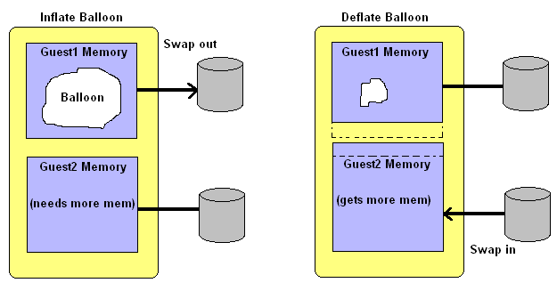
Ballooning – a neat trick!
Example of how Ballooning can be employed
ESX server can “coax” a guest OS into releasing some memory

Slide 60
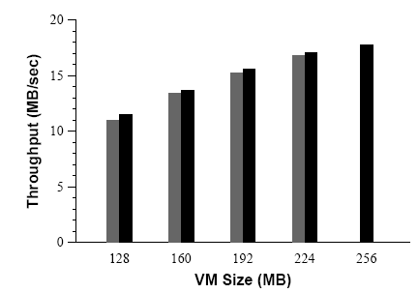
Ballooning - performance
Throughput of a Linux VM running dbench with 40 clients. The black bars plot the performance when the VM is configured with main memory sizes ranging from 128 MB to 256 MB. The gray bars plot the performance of the same VM configured with 256 MB, ballooned down to the specified size.

Slide 61
Ballooning - limitations
Ballooning is not available all the time: OS boot time, driver explicitly disabled
Ballooning does not respond fast enough for certain situations
Guest OS might have limitations to upper bound on balloon size
ESX Server preferentially uses ballooning to reclaim memory. However, when ballooning is not possible or insufficient, the system falls back to a paging mechanism. Memory is reclaimed by paging out to an ESX Server swap area on disk, without any guest involvement.

Slide 62
Sharing Memory - Page Sharing
Running multiple OSs in VMs on the same machine may result in multiple copies of the same code and data being used in the separate VMs. For example, several VMs are running the same guest OS and have the same apps or components loaded.
ESX Server can exploit the redundancy of data and instructions across several VMs
Multiple instances of the same guest OS share many of the same applications and data
Sharing across VMs can reduce total memory usage
Sharing can also increase the level of over-commitment available for the VMs

Slide 63
Page Sharing
ESX uses page content to implement sharing
ESX does not need to modify guest OS to work
ESX uses hashing to reduce scan comparison complexity
A hash value is used to summarize page content
A hint entry is used to optimize not yet shared pages
Hash table content have a COW (copy-on-write) to make a private copy when they are written too

Slide 64
Interposition with Memory Virtualization Page Sharing
VM1
VM2
Virtual
Virtual
Physical
Physical
Machine
Read-Only
Copy-on-write

Slide 65
Page Sharing: Scan Candidate PPN

Slide 66
Page Sharing: Successful Match

Slide 67
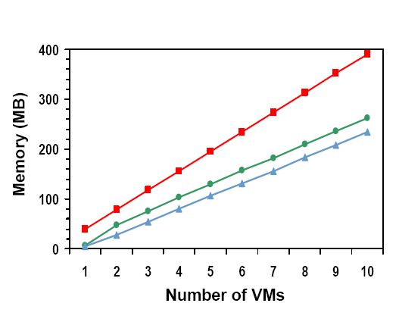
Page Sharing - performance
Best-case. workload.
Identical Linux VMs.
SPEC95 benchmarks.
Lots of potential sharing.
Metrics
Total guest PPNs.
Shared PPNs →67%.
Saved MPNs →60%.
Effective sharing
Negligible overhead

Slide 68
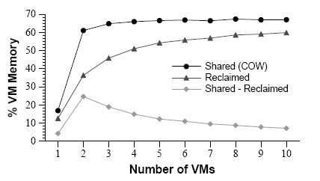
Page Sharing - performance
This graph plots the metrics shown earlier as a percentage of aggregate VM memory. For large numbers of VMs, sharing approaches 67% and nearly 60% of all VM memory is reclaimed.

Slide 69
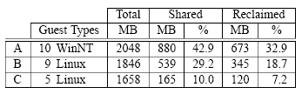
Page Sharing - performance
Real-World Page Sharing metrics from production deployments of ESX Server.
(A) 10 Win NT VMs serving users at a Fortune 50 company, running a variety of DBs (Oracle, SQL Server), web (IIS,Websphere), development (Java, VB), and other applications.
(B) 9 Linux VMs serving a large user community for a nonprofit organization, executing a mix of web (Apache), mail (Majordomo, Postfix, POP/IMAP, MailArmor), and other servers.
(C) 5 Linux VMs providing web proxy (Squid), mail (Postfix, RAV), and remote access (ssh) services toVMware employees.

Slide 70
Proportional allocation
ESX allows proportional memory allocation for VMs
With maintained memory performance
With VM isolation
Admin configurable

Slide 71
Proportional allocation
Resource rights are distributed to clients through shares
Clients with more shares get more resources relative to the total resources in the system
In overloaded situations client allocation degrades gracefully
Proportional-share can be unfair, ESX uses an “idle memory tax” to overcome this

Slide 72
Idle memory tax
When memory is scarce, clients with idle pages will be penalized compared to more active ones
The tax rate specifies the max number of idle pages that can be reallocated to active clients
When a idle paging client starts increasing its activity the pages can be reallocated back to full share
Idle page cost: k = 1/(1 - tax_rate) with tax_rate: 0 < tax_rate < 1
ESX statically samples pages in each VM to estimate active memory usage
ESX has a default tax rate of .75
ESX by default samples 100 pages every 30 seconds

Slide 73
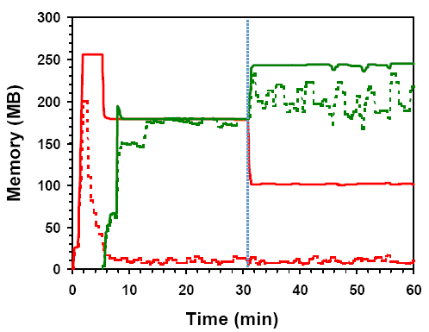
Idle memory tax
Experiment:
2 VMs, 256 MB, same shares.
VM1: Windows boot+idle. VM2:Linux boot+dbench.
Solid: usage, Dotted:active.
Change tax rate 0% → 75%
After: high tax.
Redistribute VM1→VM2.
VM1 reduced to min size.
VM2 throughput improves 30%

Slide 74
Dynamic allocation
ESX uses thresholds to dynamically allocate memory to VMs
ESX has 4 levels from high, soft, hard and low
The default levels are 6%, 4%, 2% and 1%
ESX can block a VM when levels are at low
Rapid state fluctuations are prevented by changing back to higher level only after higher threshold is significantly exceeded

Slide 75
I/O page remapping
IA-32 supports PAE to address up to 64GB of memory over a 36bit address space
ESX can remap “hot” pages in high “physical” memory addresses to lower machine addresses

Slide 76
Conclusion
Key features
Flexible dynamic partitioning
Efficient support for overcommitted workloads
Novel mechanisms
Ballooning leverages guest OS algorithms
Content-based page sharing
Proportional-sharing with idle memory tax

Slide 77
Overview
Virtualization and VMs
Processor Virtualization
Memory Virtualization
I/O Virtualization
Resource Management

Slide 78
Computer System Organization
CPU
Memory
MMU
Controller
Local Bus
Interface
High-Speed
I/O Bus
NIC
Controller
Bridge
Frame Buffer
LAN
Low-Speed
I/O Bus
CD-ROM
USB

Slide 79
Device Virtualization
Goals
Isolation
Multiplexing
Speed
Mobility
Interposition
Device Virtualization Strategies
Direct Access
Emulation
Para-virtualization

Slide 80
Direct Access Device
VM
Guest OS
CPU
Memory
MMU
Controller
Local Bus
Interface
High-Speed
I/O Bus
NIC
Controller
Bridge
Frame Buffer
LAN
Low-Speed
I/O Bus
CD-ROM
USB

Slide 81
Memory Isolation w/ Direct Access Device
VM
Guest OS
CPU
Memory
MMU
Controller
Local Bus
Interface IOMMU
High-Speed
I/O Bus
NIC
Controller
Bridge
Frame Buffer
LAN
Low-Speed
I/O Bus
CD-ROM
USB

Slide 82
Virtualization Enabled Device
VM1
Guest OS
VM2
Guest OS
CPU
Memory
MMU
Controller
Local Bus
Interface IOMMU
High-Speed
I/O Bus
vNIC 1
vNIC 2
Frame Buffer
NIC
Controller
Bridge
LAN
Low-Speed
I/O Bus
CD-ROM
USB

Slide 83
Direct Access Device Virtualization
Allow Guest OS direct access to underlying device
Positives
Fast
Simplify monitor
Limited device drivers needed
Negatives
Need hardware support for safety (IOMMU)
Need hardware support for multiplexing
Hardware interface visible to guest
Limits mobility of VM
Interposition hard by definition

Slide 84
Emulated Devices
Emulate a device in class
Emulated registers
Memory mapped I/O or programmed I/O
Convert
Intermediate representation
Back-ends per real device

Slide 85
Serial Port Example
User App
Serial Chip
ABC
Emulation
Guest
Generic Serial Layer
Serial Chip
ABC Driver
Host OS
Monitor
Serial Chip XYZ
LAN

Slide 86
Emulated Devices
Positives
Platform stability
Allows interposition
No special hardware support needed
Isolation, multiplexing implemented by monitor
Negatives
Can be slow
Drivers needed in monitor or host

Slide 87
Para-Virtualized Devices
Guest passes requests to Monitor at a higher abstraction level
Monitor calls made to initiate requests
Buffers shared between guest / monitor
Positives
Simplify monitor
Fast
Negatives
Monitor needs to supply guest-specific drivers
Bootstrapping issues

Slide 88
I/O Virtualization
Guest
Virtual Device Driver
Virtual Device Driver
Virtual Device Driver
Virtual Device Model
Virtual Device Model
Virtual Device Model
Abstract Device Model
Device Interposition
Compression Bandwidth Control Record / Replay
Overshadow Page Sharing Copy-on-Write Disks
Encryption Intrusion Detection Attestation
Device Back-ends
Remote Access Cross-device Emulation Disconnected Operation
Multiplexing
Device Sharing Scheduling Resource Management
H.W. Device Driver
H.W. Device Driver
Hardware

Slide 89

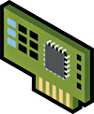
I/O Virtualization Implementations
Emulated I/O
Passthrough I/O
Hosted or Split
Hypervisor Direct
Guest OS
Guest OS
Guest OS
Device Driver
Device Driver
Device Driver
Host OS/Dom0/
Parent Domain
Device Emulation
Device Emulation
Device Emulation
I/O Stack
I/O Stack
Device
Manager
Device Driver
Device Driver
VMware Workstation, VMware Server,
Xen, Microsoft Hyper-V, Virtual Server
VMware ESX
VMware ESX (FPT)

Slide 90
Issues with I/O Virtualization
Need physical memory address translation
need to copy
need translation
need IO MMU
Need way to dispatch incoming requests

Slide 91

Passthrough I/O Virtualization
Guest OS
Guest OS
Guest OS
High Performance
Guest drives device directly
Minimizes CPU utilization
Enabled by HW Assists
I/O-MMU for DMA isolation e.g. Intel VT-d, AMD IOMMU
Partitionable I/O device e.g. PCI-SIG IOV spec
Challenges
Hardware independence
Migration, suspend/resume
Memory overcommitment
Device Driver
Device Driver
Device Driver
Virtualization
Layer
Device
Manager
I/O MMU
VF
VF
VF
I/O Device
PF
PF = Physical Function, VF = Virtual Function

Slide 92



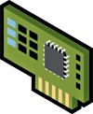
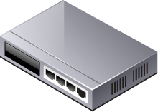

Physical Networks (1)
OS
Networking on a physical host
OS runs on bare-metal hardware
Networking stack (TCP/IP)
Network device driver
Network Interface Card (NIC)
Ethernet: Unique MAC (Media Access Control) address for identification and communication
TCP/IP Stack
Device Driver
Host
00
A0
C9
A8
70
15
6 bytes

Slide 93
Physical Networks (2)
Switch: A device that connects multiple network segment
It knows the MAC address of the NIC associated with each port
It forwards frames based on their destination MAC addresses
Each Ethernet frame contains a destination and a source MAC address
When a port receives a frame, it read the frame’s destination MAC address
port4->port6
port1->port7
Port 4
Port 5
Port 6
Port 7
Port 0
Port 1
Port 2
Port 3
Ethernet frame format
destination
…
source
6
6

Slide 94
Networking in Virtual Environments
Questions:
Imagine you want to watch a youtube video from within a VM now
How are packets delivered to the NIC?
Imagine you want to get some files from another VM running on the same host
How will packets be delivered to the other VM?
Considering
Guest OSes are no different from those running on bare-metal
Many VMs are running on the same host so dedicating a NIC to a VM is not practical
ESX Server
?
?

Slide 95

Virtual Networks on ESX
ESX Server
ESX Server
?
VM0
VM1
VM2
VM3
?
vNIC
vmknic
vSwitch
pNIC
pSwitch

Slide 96

Virtual Network Adapter
What does a virtual NIC implement
Emulate a NIC in software
Implement all functions and resources of a NIC even though there is no real hardware
Registers, tx/rx queues, ring buffers, etc.
Each vNIC has a unique MAC address
For better out-of-the-box experience, VMware emulates two widely-used NICs
Most modern OSes have inbox drivers for them
vlance: strict emulation of AMD Lance PCNet32
e1000: strict emulation of Intel e1000 and is more efficient than vlance
vNICs are completely decoupled from hardware NIC
Guest OS
Guest TCP/IP stack
Guest
Device Driver
Device Emulation
vSwitch
Physical
Device Driver
Host

Slide 97
Virtual Switch
How virtual switch works
A software switch implementation
Work like any regular physical switch
Forward frames based on their destination MAC addresses
The virtual switch forwards frames between the vNIC and the pNIC
Allow the pNIC to be shared by all the vNICs on the same vSwitch
The packet can be dispatched to either another VM’s port or the uplink pNIC’s port
VM-VM
VM-Uplink
(Optional) bandwidth management, security filters, and uplink NIC teaming
Guest OS
Guest TCP/IP stack
Guest
Device Driver
Device Emulation
vSwitch
Physical
Device Driver
Host

Slide 98
Para-virtualized Virtual NIC
Issues with emulated vNIC
At high data rate, certain I/O operations running in a virtualized environment will be less efficient than running on bare-metal
Instead, VMware provided several new types of “NIC”s
vmxnet2/vmxnet3
Not like vlance or e1000, there is no corresponding hardware
Designed with awareness of running inside a virtualized environment
Intend to reduce the time spent on performing I/O operations less efficient to run in a virtualized environment
Better performance than vlance and e1000
You might need to install VMware Tools to get the guest driver
For vmxnet3 vNIC, the driver code has been upstreamed into Linux kernel

Slide 99
Values of Virtual Networking
Physical device sharing
You can dedicate a pNIC to a VM but think of running hundreds of VMs on a host
Decoupling of virtual hardware from physical hardware
Migrating a VM from one server to another that does not have the same pNIC is not an issue
Easy addition of new networking capabilities
Example: NIC Teaming (used for link aggregation and fail over)
VMware’s vSwitch supports this feature
One-time configuration shared by all the VMs on the same vSwitch

Slide 100
VMDirectPath I/O
Guest OS
Guest directly controls the physical device hardware
Bypass the virtualization layers
Reduced CPU utilization and improved performance
Requires I/O MMU
Challenges
Lose some virtual networking features, such as VMotion
Memory over-commitment (no visibility of DMAs to guest memory)
Guest TCP/IP stack
Guest
Device Driver
Device Emulation
vSwitch
Physical
Device Driver
I/O MMU

Slide 101



Key Issues in Network Virtualization
Virtualization Overhead
Extra layers of packet processing and overhead
Security and Resource Sharing
VMware provides a range of solutions to address these issues
VM0
VM1
VM2
VM3
ESX Server
vSwitch

Slide 102
Virtualization Overhead
non-virtualized
virtualized
pNIC Data Path:
NIC driver
vNIC Data Path:
Guest vNIC driver
vNIC device emulation
vSwitch
pNIC driver
Should reduce both per-packet and per-byte overhead
OS
Guest OS
TCP/IP stack
Guest TCP/IP stack
Device Driver
Guest
Device Driver
Host
Device Emulation
vSwitch
Physical
Device Driver
Host

Slide 103
Minimizing Virtualization Overhead
Make use of TSO
TCP Segmentation Offload
Segmentation
MTU: Maximum Transmission Unit
Data need to be broken down to smaller segments (MTU) that can pass all the network elements like routers and switches between the source and destination
Modern NIC can do this in hardware
The OS’s networking stack queues up large buffers (>MTU) and let the NIC hardware split them into separate packets (<= MTU)
Reduce CPU usage

Slide 104
Minimizing Virtualization Overhead (2)
LRO for Guest OS that supports it
Large Receive Offload
Aggregating multiple incoming packets from a single stream into a larger buffer before they are passed higher up the networking stack
Reduce the number of packets processed at each layer
Working with TSO, significantly reduces VM-VM packet processing overhead if the destination VM supports LRO
a much larger effective MTU
TSO
LRO

Slide 105
Minimizing Virtualization Overhead (3)
Moderate virtual interrupt rate
Interrupts are generated by the vNIC to request packet processing/completion by the vCPU
At low traffic rates, it makes sense to raise one interrupt per packet event (either Tx or Rx)
10Gbps Ethernet fast gaining dominance
Packet rate a ~800K pkts/sec with 1500-byte packets and handling one interrupt per packet will unduly burden the vCPU
Interrupt moderation: raise interrupt for a batch of packets
Tradeoff between throughput and latency
Without moderation
intr
pkt arrival
With moderation
intr
pkt arrival

Slide 106
Performance
Goal: Understand what to expect with vNIC networking performance on ESX 4.0 on the lastest Intel family processor code-named Nehalem
10Gbps line rate for both Tx and Rx with a single-vcpu single-vNIC RedHat Enterprise Linux 5 on Nehalem
Over 800k Rx pkts/s (std MTU size pkts) for TCP traffic
30Gbps aggregated throughput with one Nehalem server
Many workloads do not have much network traffic though
Think about your high speed Internet connections (DSL, cable modem)
Exchange Server: a very demanding enterprise-level mail-server workload
No. of heavy user | MBits RX/s | MBits TX/s | Packets RX/s | Packets TX/s
1,000 | 0.43 | 0.37 | 91 | 64
2,000 | 0.93 | 0.85 | 201 | 143
4,000 | 1.76 | 1.59 | 362 | 267

Slide 107
Performance: SPECWeb2005
SPECweb 2005
Heavily exercise network I/O (throughput, latency, connections)
Results (circa early 2009, higher is better)
Rock Web Server, Rock JSP Engine
Red Hat Enterprise Linux 5
Network Utilization of SPECWeb2005
Environment | SUT | Cores | Scores
native | HP ProLiant DL580 G5 (AMD Opteron) | 16 | 43854
virtual (w/ multi VMs) | HP ProLiant DL580 G5 (AMD Opteron) | 16 | 44000
Workload | Number of Sessions | MBits TX/s
Banking | 2300 | ~90
E-Commerce | 3200 | ~330
Support | 2200 | ~1050

Slide 108
Security
VLAN (Virtual LAN) support
IEEE 802.1Q standard
Virtual LANs allow separate LANs on a physical LAN
Frames transmitted on one VLAN won’t be seen by other VLANs
Different VLANs can only communicate with one another with the use of a router
On the same VLAN, additional security protections are available
Promiscuous mode disabled by default to avoid seeing unicast traffic to other nodes on the same vSwitch
In promiscuous mode, a NIC receives all packets on the same network segment. In “normal mode”, a NIC receives packets addressed only to its own MAC address
MAC address change lockdown
By changing MAC address, a VM can listen to traffic of other VMs
Do not allow VMs to send traffic that appears to come from nodes on the vSwitch other than themselves

Slide 109
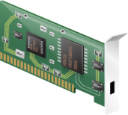
Advanced Security Features
What about traditional advanced security functions in a virutalized environment
Firewall
Intrusion detection/prevention system
Deep packet insepection
These solutions are normally deployed with dedicated hardware appliances
No visibility into traffic on the vSwitch
How would you implement a solution in such a virtualized network?
Run a security appliance in a VM on the same host
Protected VM
Appliance VM
vNIC
vNIC
vSwitch

Slide 110
vNetwork Appliance API
You can implement these advanced functions with vNetwork Appliance APIs
a flexible/efficient framework integrated with the virtualization software to do packet inspection efficiently inside a VM
It sits in between the vSwitch and the vNIC and can inspect/drop/alter/inject frames
No footprint and minimal changes on the protected VMs
Support VMotion
The API is general enough to be used for anything that requires packet inspection
Load balancer
Protected VM
Appliance VM
slow path agent
vNIC
vNIC
fast path agent
vSwitch

Slide 111
VMotion (1)
VMotion
Perform live migrations of a VM between ESX servers with application downtime unnoticeable to the end-users
Allow you to proactively move VMs away from failing or underperforming servers
Many advanced features such as DRS (Distributed Resource Scheduling) are using VMotion
During a VMotion, the active memory and precise execution state (processor, device) of a VM is transmitted
The VM retains its network identity and connections after migration

Slide 112
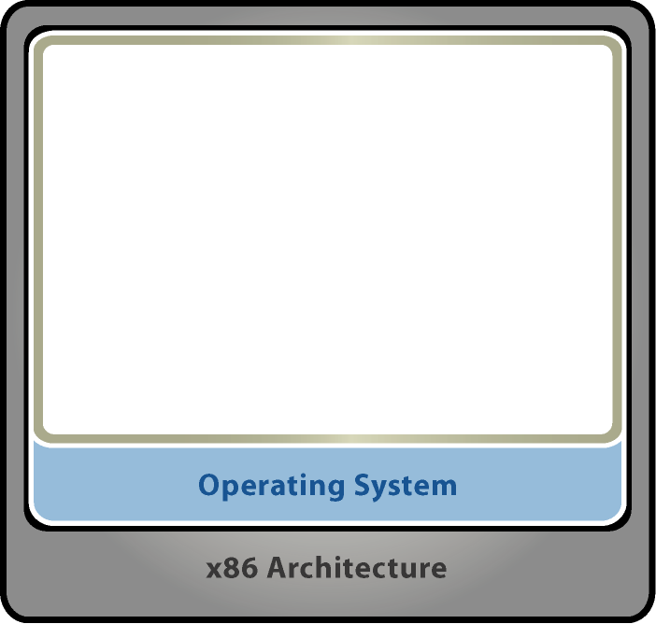


VMotion (2)
ESX Host 1
ESX Host 2
VMotion steps (simplified)
VM C begins to VMotion to ESX Host 2
VM state (processor and device state, memory, etc.) is copied over the network
Suspend the source VM and resume the destination VM
Complete MAC address move
A
B
C
MACA
MACB
MACC
IPA
IPB
IPC
RARP for MAC move (broadcast to the entire network)
MACA MACB
MACC
MACC
MACC
VMotion Traffic
Physical Switch #1
Physical Switch #2

Slide 113


vNetwork Distributed Switch (vDS)
Centralized Management
Same configuration and policy across hosts
Make VMotion easier without the need for network setup on the new host
Create and configure just once
Port state can be persistent and migrated
Aplications like firewall or traffic monitoring need such stateful information
Scalability
Think of a cloud deployment with thousands of VMs
vSS
vSS
vSS
vDS

Slide 114
Conclusions
Drive 30Gbps virtual networking traffic from a single host
VMware has put significant efforts on performance improvement
You shoud not worry about virtual networking performance
You can do more with virutal networking
VMotion-> zero downtime, high availability, etc.
In the era of cloud computing
Efficient management
Security
Scalability

Slide 115
Overview
Virtualization and VMs
Processor Virtualization
Memory Virtualization
I/O Virtualization
Resource Management

Slide 116
Virtualized Resource Management
Physical resources
Actual “host” hardware
Processors, memory, I/O devices, etc.
Virtual resources
Virtual “guest” hardware abstractions
Processors, memory, I/O devices, etc.
Resource management
Map virtual resources onto physical resources
Multiplex physical hardware across VMs
Manage contention based on admin policies

Slide 117
Resource Management Goals
Performance isolation
Prevent VMs from monopolizing resources
Guarantee predictable service rates
Efficient utilization
Exploit undercommitted resources
Overcommit with graceful degradation
Support flexible policies
Meet absolute service-level agreements
Control relative importance of VMs

Slide 118
Talk Overview
Resource controls
Processor scheduling
Memory management
NUMA scheduling
Distributed systems
Summary

Slide 119
Resource Controls
Useful features
Express absolute service rates
Express relative importance
Grouping for isolation or sharing
Challenges
Simple enough for novices
Powerful enough for experts
Physical resource consumption vs. application-level metrics
Scaling from single host to cloud

Slide 120
VMware Basic Controls
Shares
Specify relative importance
Entitlement directly proportional to shares
Abstract relative units, only ratios matter
Reservation
Minimum guarantee, even when system overloaded
Concrete absolute units (MHz, MB)
Admission control: sum of reservations ≤ capacity
Limit
Upper bound on consumption, even if underloaded
Concrete absolute units (MHz, MB)

Slide 121
Shares Examples
Change shares for VM
Dynamic reallocation
Add VM, overcommit
Graceful degradation
Remove VM
Exploit extra resources

Slide 122
Reservation Example
Total capacity
1800 MHz reserved
1200 MHz available
Admission control
2 VMs try to power on
Each reserves 900 MHz
Unable to admit both
VM1 powers on
VM2 not admitted
VM1
VM2

Slide 123
Limit Example
Current utilization
1800 MHz active
1200 MHz idle
Start CPU-bound VM
600 MHz limit
Execution throttled
New utilization
2400 MHz active
600 MHz idle
VM prevented from using idle resources
VM

Slide 124
VMware Resource Pools
Motivation
Allocate aggregate resources for sets of VMs
Isolation between pools, sharing within pools
Flexible hierarchical organization
Access control and delegation
What is a resource pool?
Named object with permissions
Reservation, limit, and shares for each resource
Parent pool, child pools, VMs

Slide 125
Resource Pools Example
Admin manages users
Policy: Alice’s share is 50% more than Bob’s
Users manage own VMs
Not shown: resvs, limits
VM allocations:
Admin
300 Admin
200 Admin
Alice
Bob
75 Alice
75 Alice
400 Bob
30%
VM1
VM2
VM3
40%
30%

Slide 126
Example: Bob Adds VM
Same policy
Pools isolate users
Alice still gets 50% more than Bob
VM allocations:
Admin
300 Admin
200 Admin
Alice
Bob
30%
13%
75 Alice
75 Alice
400 Bob
800 Bob
VM1
VM2
VM3
VM4
27%
30%

Slide 127
Resource Controls: Future Directions
Application-level metrics
Users think in terms of transaction rates, response times
Requires detailed app-specific knowledge and monitoring
Can layer on top of basic physical resource controls
Other controls?
Real-time latency guarantees
Price-based mechanisms and multi-resource tradeoffs
Emerging DMTF standard
Reservation, limit, “weight” + resource pools
Authors from VMware, Microsoft, IBM, Citrix, etc.

Slide 128
Talk Overview
Resource controls
Processor scheduling
Memory management
NUMA scheduling
Distributed systems
Summary

Slide 129
Processor Scheduling
Useful features
Accurate rate-based control
Support both UP and SMP VMs
Exploit multi-core, multi-threaded CPUs
Grouping mechanism
Challenges
Efficient scheduling of SMP VMs
VM load balancing, interrupt balancing
Cores/threads may share cache, functional units
Lack of control over µarchitectural fairness
Proper accounting for interrupt-processing time

Slide 130
VMware Processor Scheduling
Scheduling algorithms
Rate-based controls
Hierarchical resource pools
Inter-processor load balancing
Accurate accounting
Multi-processor VM support
Illusion of dedicated multi-processor
Near-synchronous co-scheduling of VCPUs
Support hot-add VCPUs
Modern processor support
Multi-core sockets with shared caches
Simultaneous multi-threading (SMT)

Slide 131
Proportional-Share Scheduling
Simplified virtual-time algorithm
Virtual time = usage / shares
Schedule VM with smallest virtual time
Example: 3 VMs A, B, C with 3 : 2 : 1 share ratio
A
2
4
4
6
8
8
8
10
10
B
3
3
6
6
6
9
9
9
12
C
6
6
6
6
6
6
12
12
12

Slide 132
Hierarchical Scheduling
Admin
Motivation
Enforce fairness at each resource pool
Unused resources flow to closest relatives
Approach
Maintain virtual time at each node
Recursively choose node with smallest virtual time
vtime = 2000
vtime = 2100
Alice
Bob
vtime = 2200
vtime = 1800
vtime=2100
vtime = 2200
VM1
VM2
VM3
VM4
flow unused time

Slide 133
Inter-Processor Load Balancing
Motivation
Utilize multiple processors efficiently
Enforce global fairness
Amortize context-switch costs
Preserve cache affinity
Approach
Per-processor dispatch and run queues
Scan remote queues periodically for fairness
Pull whenever a physical CPU becomes idle
Push whenever a virtual CPU wakes up
Consider cache affinity cost-benefit

Slide 134
Co-Scheduling SMP VMs
Motivation
Maintain illusion of dedicated multiprocessor
Correctness: avoid guest BSODs / panics
Performance: consider guest OS spin locks
VMware Approach
Limit “skew” between progress of virtual CPUs
Idle VCPUs treated as if running
Deschedule VCPUs that are too far ahead
Schedule VCPUs that are behind
Alternative: Para-virtualization

Slide 135
Charging and Accounting
Resource usage accounting
Pre-requisite for enforcing scheduling policies
Charge VM for consumption
Also charge enclosing resource pools
Adjust accounting for SMT systems
System time accounting
Time spent handling interrupts, BHs, system threads
Don’t penalize VM that happened to be running
Instead charge VM on whose behalf work performed
Based on statistical sampling to reduce overhead

Slide 136
Processor Scheduling: Future Directions
Shared cache management
Explicit cost-benefit tradeoffs for migrations e.g. based on cache miss-rate curves (MRCs)
Compensate VMs for co-runner interference
Hardware cache QoS techniques
Power management
Exploit frequency and voltage scaling (P-states)
Exploit low-power, high-latency halt states (C-states)
Without compromising accounting and rate guarantees

Slide 137
Talk Overview
Resource controls
Processor scheduling
Memory management
NUMA scheduling
Distributed systems
Summary

Slide 138
Memory Management
Useful features
Efficient memory overcommitment
Accurate resource controls
Exploit deduplication opportunities
Leverage hardware capabilities
Challenges
Reflecting both VM importance and working-set
Best data to guide decisions private to guest OS
Guest and meta-level policies may clash

Slide 139
Memory Virtualization
Extra level of indirection
Virtual → “Physical” Guest maps VPN to PPN using primary page tables
“Physical” → Machine VMM maps PPN to MPN
Shadow page table
Traditional VMM approach
Composite of two mappings
For ordinary memory references, hardware maps VPN to MPN
Nested page table hardware
Recent AMD RVI, Intel EPT
VMM manages PPN-to-MPN table
No need for software shadows
VPN
guest
shadow
page table
PPN
hardware TLB
VMM
MPN

Slide 140
Reclaiming Memory
Required for memory overcommitment
Increase consolidation ratio, incredibly valuable
Not supported by most hypervisors
Many VMware innovations [Waldspurger OSDI ’02]
Traditional: add transparent swap layer
Requires meta-level page replacement decisions
Best data to guide decisions known only by guest
Guest and meta-level policies may clash
Example: “double paging” anomaly
Alternative: implicit cooperation
Coax guest into doing page replacement
Avoid meta-level policy decisions

Slide 141
Ballooning
inflate balloon (+ pressure)‏
Guest OS
may page out to virtual disk
balloon
Guest OS
guest OS manages memory implicit cooperation
balloon
Guest OS
may page in from virtual disk
deflate balloon (– pressure)‏

Slide 142
Page Sharing
Motivation
Multiple VMs running same OS, apps
Deduplicate redundant copies of code, data, zeros
Transparent page sharing
Map multiple PPNs to single MPN copy-on-write
Pioneered by Disco [Bugnion et al. SOSP ’97], but required guest OS hooks
VMware content-based sharing
General-purpose, no guest OS changes
Background activity saves memory over time

Slide 143
Page Sharing: Scan Candidate PPN
011010
110101
010111
101100
hash page contents
…2bd806af
VM 1
VM 2
VM 3
hint frame
Machine Memory
Hash:
VM:
PPN:
MPN:
…06af
3
43f8
123b
hash
table

Slide 144
Page Sharing: Successful Match
VM 1
VM 2
VM 3
shared frame
Machine Memory
Hash:
Refs:
MPN:
…06af
2
123b
hash
table

Slide 145
Memory Reclamation: Future Directions
Memory compression
Old idea: compression cache [Douglis USENIX ’93], Connectix RAMDoubler (MacOS mid-90s)
Recent: Difference Engine [Gupta et al. OSDI ’08], future VMware ESX release
Sub-page deduplication
Emerging memory technologies
Swapping to SSD devices
Leveraging phase-change memory

Slide 146
Memory Allocation Policy
Traditional approach
Optimize aggregate system-wide metric
Problem: no QoS guarantees, VM importance varies
Pure share-based approach
Revoke from VM with min shares-per-page ratio
Problem: ignores usage, unproductive hoarding
Desired behavior
VM gets full share when actively using memory
VM may lose pages when working-set shrinks

Slide 147
Reclaiming Idle Memory
Tax on idle memory
Charge more for idle page than active page
Idle-adjusted shares-per-page ratio
Tax rate
Explicit administrative parameter
0% ≈ “plutocracy” … 100% ≈ “socialism”
High default rate
Reclaim most idle memory
Some buffer against rapid working-set increases

Slide 148
Idle Memory Tax: 0%
Experiment
2 VMs, 256 MB, same shares
VM1: Windows boot+idle
VM2: Linux boot+dbench
Solid: usage, Dotted: active
Change tax rate
Before: no tax
VM1 idle, VM2 active
Get same allocation
Memory (MB)‏
Time (min)‏

Slide 149
Idle Memory Tax: 75%
Experiment
2 VMs, 256 MB, same shares
VM1: Windows boot+idle
VM2: Linux boot+dbench
Solid: usage, Dotted: active
Change tax rate
After: high tax
Redistributed VM1 → VM2
VM1 reduces to min size
VM2 throughput improves more than 30%
Memory (MB)‏
Time (min)‏

Slide 150
Allocation Policy: Future Directions
Memory performance estimates
Estimate effect of changing allocation
Miss-rate curve (MRC) construction
Improved coordination of mechanisms
Ballooning, compression, SSD, swapping
Leverage guest hot-add/remove
Large page allocation efficiency and fairness

Slide 151
Talk Overview
Resource controls
Processor scheduling
Memory management
NUMA scheduling
Distributed systems
Summary

Slide 152
NUMA Scheduling
NUMA platforms
Non-uniform memory access
Node = processors + local memory + cache
Examples: IBM x-Series, AMD Opteron, Intel Nehalem
Useful features
Automatically map VMs to NUMA nodes
Dynamic rebalancing
Challenges
Tension between memory locality and load balance
Lack of detailed counters on commodity hardware

Slide 153
VMware NUMA Scheduling
Periodic rebalancing
Compute VM entitlements, memory locality
Assign “home” node for each VM
Migrate VMs and pages across nodes
VM migration
Move all VCPUs and threads associated with VM
Migrate to balance load, improve locality
Page migration
Allocate new pages from home node
Remap PPNs from remote to local MPNs (migration)
Share MPNs per-node (replication)

Slide 154
NUMA Scheduling: Future Directions
Better page migration heuristics
Determine most profitable pages to migrate
Some high-end systems (e.g. SGI Origin) had per-page remote miss counters
Not available on commodity x86 platforms
Expose NUMA to guest?
Enable guest OS optimizations
Impact on portability

Slide 155
Talk Overview
Resource controls
Processor scheduling
Memory management
NUMA scheduling
Distributed systems
Summary

Slide 156
Distributed Systems
Useful features
Choose initial host when VM powers on
Migrate running VMs across physical hosts
Dynamic load balancing
Support cloud computing, multi-tenancy
Challenges
Migration decisions involve multiple resources
Resource pools can span many hosts
Appropriate migration thresholds
Assorted failure modes (hosts, connectivity, etc.)

Slide 157
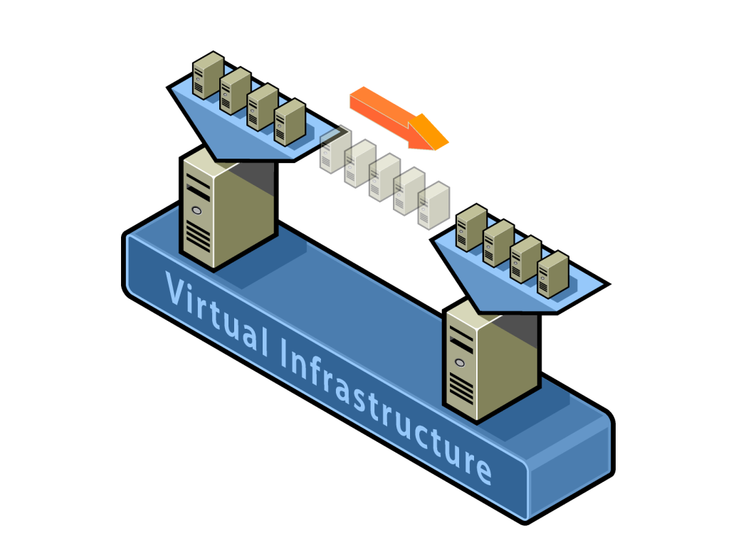
VMware vMotion
“Hot” migrate VM across hosts
Transparent to guest OS, apps
Minimal downtime (sub-second)
Requirements
Shared storage (e.g. SAN/NAS/iSCSI)
Same subnet (no forwarding proxy)
Compatible processors (EVC)
Details
Track modified pages (write-protect)
Pre-copy step sends modified pages
Keep sending “diffs” until converge
Start running VM on destination host
Exploit meta-data (shared, swapped)

Slide 158
VMware DRS/DPM
DRS = Distributed Resource Scheduler
Cluster-wide resource management
Uniform controls, same as available on single host
Flexible hierarchical policies and delegation
Configurable automation levels, aggressiveness
Configurable VM affinity/anti-affinity rules
Automatic VM placement
Optimize load balance across hosts
Choose initial host when VM powers on
Dynamic rebalancing using vMotion
DPM = Distributed Power Management
Power off unneeded hosts, power on when needed again

Slide 159
DRS System Architecture
clients
UI
SDK
DB
DRS
1
VirtualCenter
•••
DRS
n
stats + actions
•••
•••
•••
cluster
1
cluster
n

Slide 160
DRS Balancing Details
Compute VM entitlements
Based on resource pool and VM resource settings
Don’t give VM more than it demands
Reallocate extra resources fairly
Compute host loads
Load ≠ utilization unless all VMs equally important
Sum entitlements for VMs on host
Normalize by host capacity
Consider possible vMotions
Evaluate effect on cluster balance
Incorporate migration cost-benefit for involved hosts
Recommend best moves (if any)

Slide 161
Simple Balancing Example
4GHz
4GHz
VM1
VM2
VM3
VM4
3GHz
2GHz
1GHz
1GHz
Host normalized
entitlement = 1.25
Host normalized
entitlement = 0.5
Recommendation: migrate VM2

Slide 162
DPM Details (Simplified)
Set target host demand/capacity ratio (63% ± 18%)
If some hosts above target range, consider power on
If some hosts below target range, consider power off
For each candidate host to power on
Ask DRS “what if we powered host off and rebalanced?”
If more hosts within (or closer to) target, recommend action
Stop once no hosts are above target range
For each candidate host to power off
Ask DRS “what if we powered host off and rebalanced?”
If more hosts within (or closer to) target, recommend action
Stop once no hosts are below target range

Slide 163
Distributed I/O Management
Host-level I/O scheduling
Arbitrate access to local NICs and HBAs
Disk I/O bandwidth management (SFQ)
Network traffic shaping
Distributed systems
Host-level scheduling insufficient
Multiple hosts access same storage array / LUN
Array behavior complex, need to treat as black box
VMware PARDA approach [Gulati et al. FAST ’09]

Slide 164



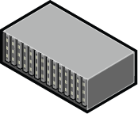
PARDA Architecture
Host-Level Issue Queues
SFQ
Array Queue
SFQ
Storage Array
SFQ
Queue lengths varied dynamically
based on average request latency

Slide 165
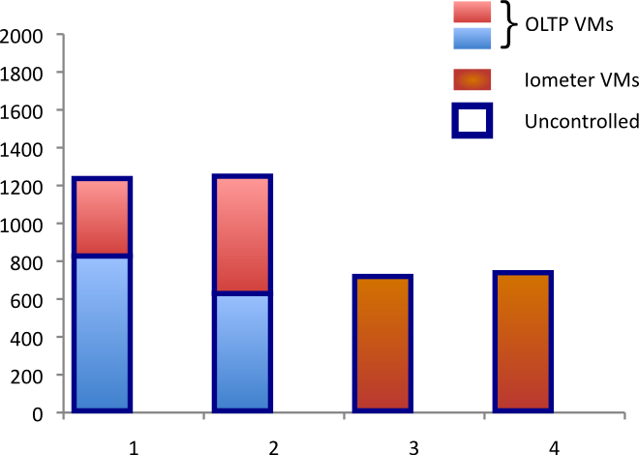
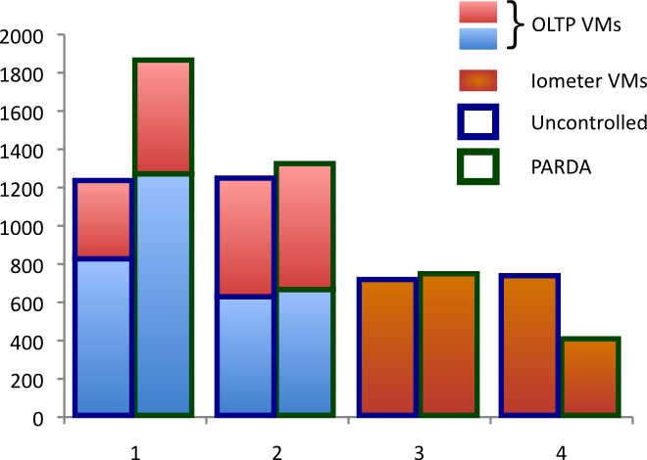

PARDA End-to-End I/O Control
VM Shares
20 10 10 10 20 10
OLTP
OLTP
OLTP
OLTP
Iomtr
Iomtr
Throughput (IOPS)
30 20 20 10
Host Shares
Hosts
Shares respected independent of VM placement
Specified I/O latency threshold enforced (25 ms)

Slide 166
Distributed Systems: Future Directions
Large-scale cloud management
Virtual disk placement/migrations
Leverage “storage vMotion” as primitive
Storage analog of DRS
VMware BASIL approach [Gulati et al. FAST ’10]
Proactive migrations
Detect longer-term trends
Move VMs based on predicted load

Slide 167
Summary
Resource management
Controls for specifying allocations
Processor, memory, NUMA, I/O, power
Tradeoffs between multiple resources
Distributed resource management
Rich research area
Plenty of interesting open problems
Many unique solutions

Slide 168
CPU Resource Entitlement
Resources that each VM “deserves”
Combining shares, reservation, and limit
Allocation if all VMs full active (e.g. CPU-bound)
Concrete units (MHz)
Entitlement calculation (conceptual)
Entitlement initialized to reservation
Hierarchical entitlement distribution
Fine-grained distribution (e.g. 1 MHz at a time), preferentially to lowest entitlement/shares
Don’t exceed limit
What if VM idles?
Don’t give VM more than it demands
CPU scheduler distributes resources to active VMs
Unused reservations not wasted

Slide 169
Overview
Virtualization and VMs
Processor Virtualization
Memory Virtualization
I/O Virtualization
Resource Management
Xen

Slide 170
Example: Xen VM
Xen: Open-source System VMM for 80x86 ISA
Project started at University of Cambridge, GNU license model
Original vision of VM is running unmodified OS
Significant wasted effort just to keep guest OS happy
“paravirtualization” - small modifications to guest OS to simplify virtualization
3 Examples of paravirtualization in Xen:
To avoid flushing TLB when invoke VMM, Xen mapped into upper 64 MB of address space of each VM
Guest OS allowed to allocate pages, just check that didn’t violate protection restrictions
To protect the guest OS from user programs in VM, Xen takes advantage of 4 protection levels available in 80x86
Most OSes for 80x86 keep everything at privilege levels 0 or at 3.
Xen VMM runs at the highest privilege level (0)
Guest OS runs at the next level (1)
Applications run at the lowest privilege level (3)

Slide 171
Xen and I/O
To simplify I/O, privileged VMs assigned to each hardware I/O device: “driver domains”
Xen Jargon: “domains” = Virtual Machines
Driver domains run physical device drivers, although interrupts still handled by VMM before being sent to appropriate driver domain
Regular VMs (“guest domains”) run simple virtual device drivers that communicate with physical devices drivers in driver domains over a channel to access physical I/O hardware
Data sent between guest and driver domains by page remapping

Slide 172
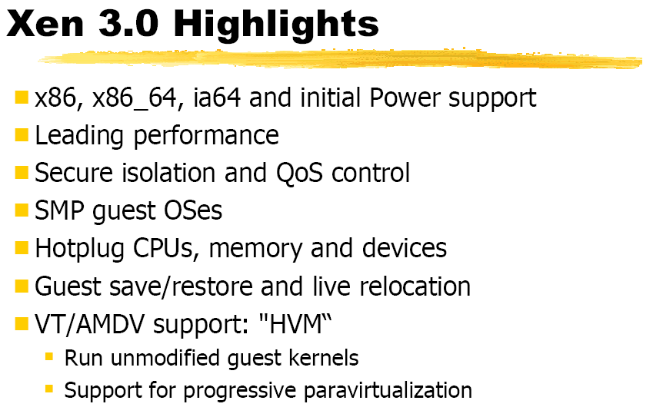
Xen 3.0

Slide 173
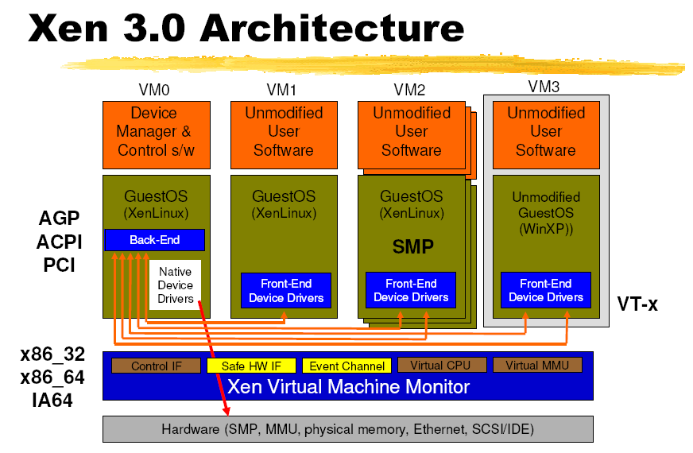
Xen 3.0

Slide 174
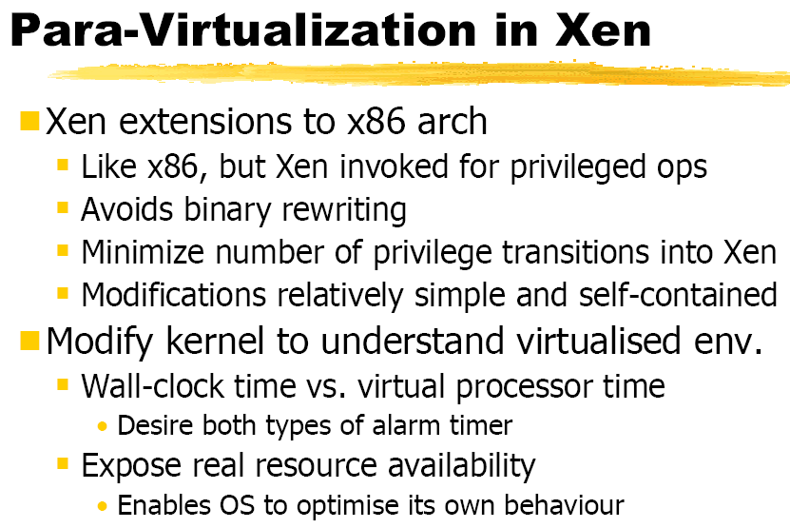
Xen 3.0

Slide 175
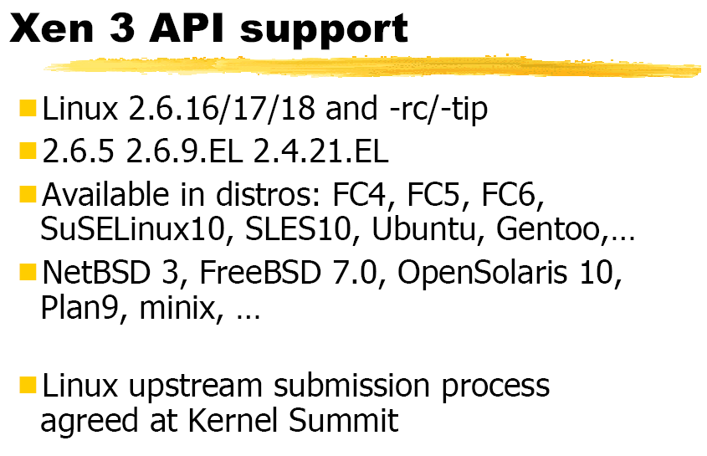
Xen 3.0

Slide 176
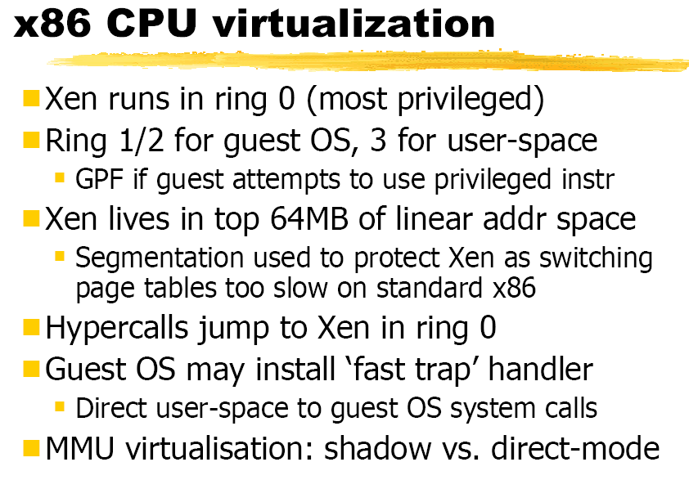
Xen 3.0

Slide 177
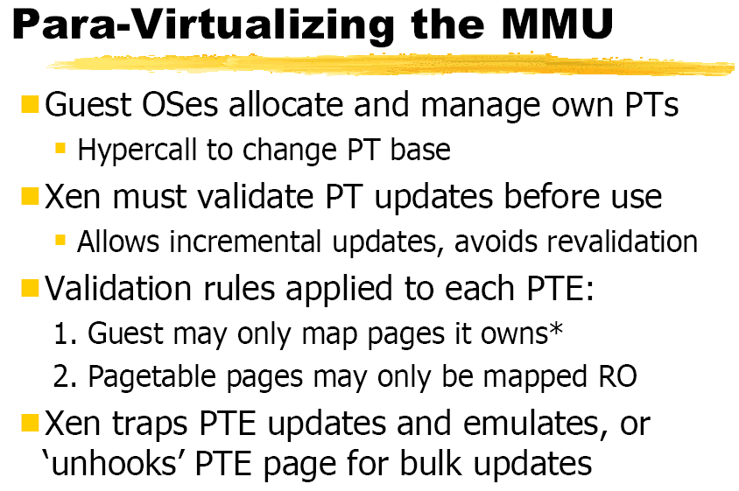
Xen 3.0

Slide 178
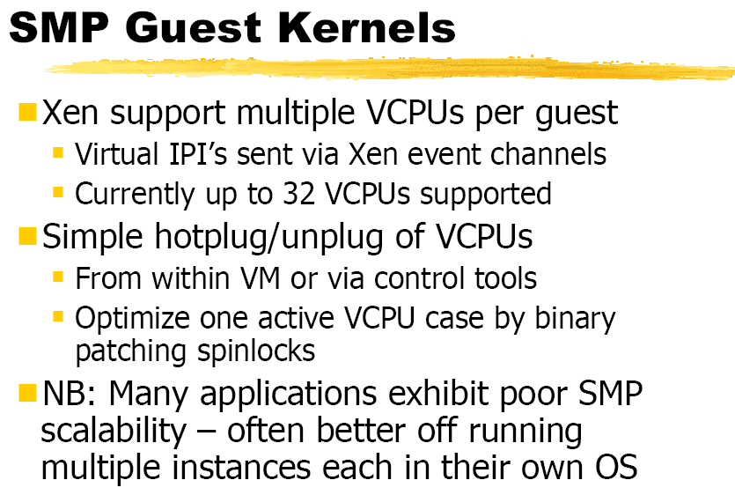
Xen 3.0

Slide 179
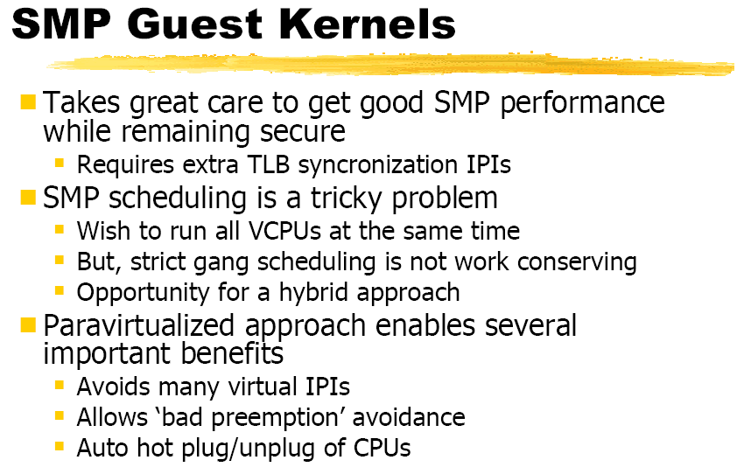
Xen 3.0

Slide 180
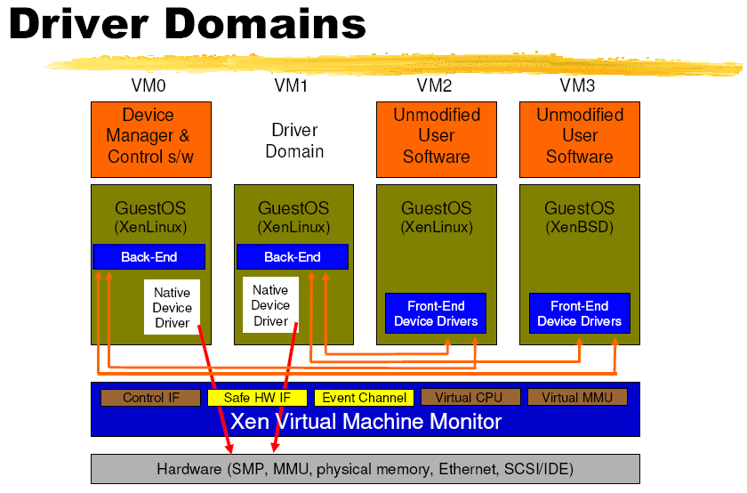
Xen 3.0

Slide 181
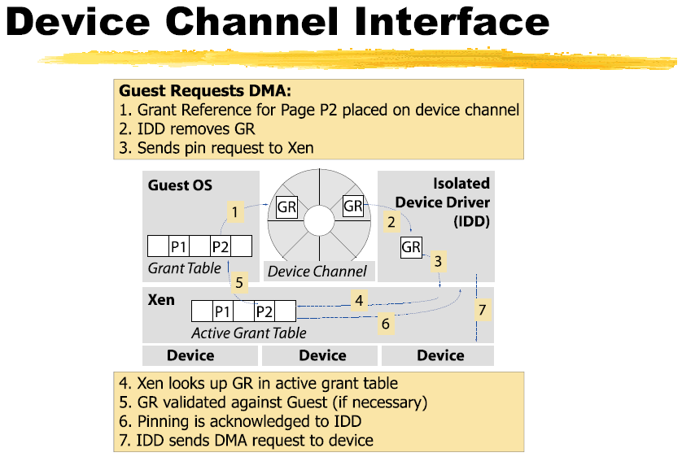
Xen 3.0

Slide 182
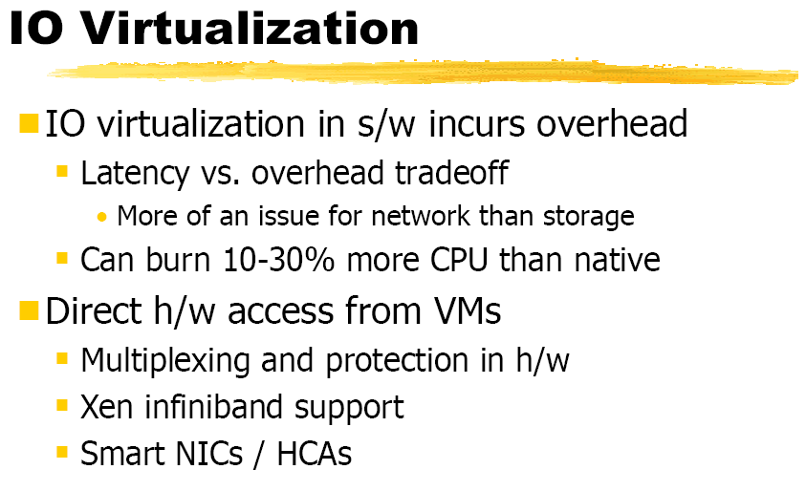
Xen 3.0

Slide 183
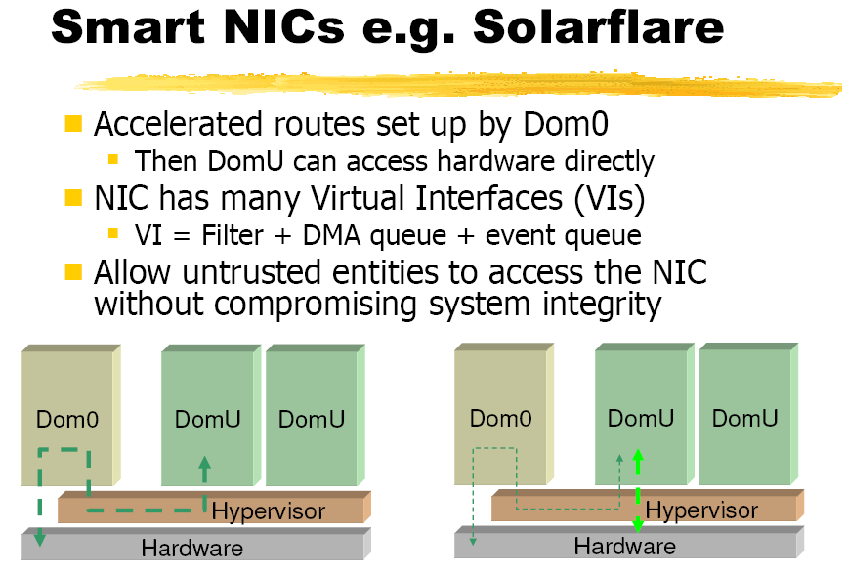
Xen 3.0

Slide 184
Xen Performance
Performance relative to native Linux for Xen for 6 benchmarks from Xen developers
Notes:
User-level processor-bound programs? I/O-intensive workloads? I/O-Bound I/O-Intensive

Slide 185
Xen Performance, Part II
Subsequent study noticed Xen experiments based on 1 Ethernet network interfaces card (NIC), and single NIC was a performance bottleneck

Slide 186
Xen Performance, Part III
> 2X instructions for guest VM + driver VM
> 4X L2 cache misses
12X – 24X Data TLB misses

Slide 187
Xen Performance, Part IV
> 2X instructions: page remapping and page transfer between driver and guest VMs and due to communication between the 2 VMs over a channel
4X L2 cache misses: Linux uses zero-copy network interface that depends on ability of NIC to do DMA from different locations in memory
Since Xen does not support “gather DMA” in its virtual network interface, it can’t do true zero-copy in the guest VM
12X – 24X Data TLB misses: 2 Linux optimizations
Superpages for part of Linux kernel space, and 4MB pages lowers TLB misses versus using 1024 4 KB pages. Not in Xen
PTEs marked global are not flushed on a context switch, and Linux uses them for its kernel space. Not in Xen
Future Xen may address 2. and 3., but 1. inherent?

